Slide 1

Thesis Dissertation: Discovering and beneficially utilizing differences between males and females towards a precision medicine approach for Alzheimer’s Disease
by Farheen
Supervisor :
Dr. Nikolaos Mavridis
(Academic & Consultant in Robotics and Artificial Intelligence- Numerous clients M.I.T)
Notes:
0:09 => 0:09

Slide 2
CONTENT
Abstract
Introduction
Aims and objectives
Dataset
Research methodology
Results
Discussion
Future extensions
Conclusion
References
Notes:
0:06 => 0:15

Slide 3
ABSTRACT
The two main aims of this project were
To contribute to the overall knowledge of sex and gender differences in Alzheimer’s Disease via studying atrophy patterns (using magnetic resonance imaging) of brain regions with sex, age, education, and risk factors for AD.
To create sex-specific models of cognitive decline.
The results of this project could have possible implications for precise preventions, diagnostic algorithms, or prognostic markers, with the overall goal of reducing the AD burden on both patients and caregivers.
Notes:
0:11 => 0:26 The two main aims of this project were
To contribute to the overall knowledge of sex and gender differences in Alzheimer’s Disease via studying atrophy patterns (using magnetic resonance imaging) of brain regions with sex, age, education, and risk factors for AD. To create sex-specific models of cognitive decline. The results of this project could have possible implications for precise preventions, diagnostic algorithms, or prognostic markers, with the overall goal of reducing the AD burden on both patients and caregivers.

Slide 4
ABSTRACT
The data on which our analysis is performed is divided into two cohorts.
ASPSF COHORT
It consisted of healthy patient records
PRODEM COHORT
It consisted of unhealthy i.e., demented patients' records.

Slide 5
ABSTRACT
Method used:
For AIM 1 :
Ordinary least squares (OLS) linear regression was used to analyze the effect of the response variables sex, age, hypertension (in ASPSF only), and brain morphometry measurements as independent variables (model 1). The inverse model (with brain morphometry as response variables, model 2) was also investigated.
For AIM 2 :
Logistic regression, Decision Trees regressor, Random Forest regression, and Extreme Gradient Boosting (XGBoost) regressor were used to cross-sectionally model the effect of age, education, sex, and brain morphometry measurements on a cognitive measure (LGSSU = sum memory score of the Lern- und Gedächtnistest, LGT-3). We then disaggregated by sex to see if the results differed between men and women.

Slide 6

Introduction
Background : Alzheimer's disease (AD) is a progressive brain disease that gradually erodes memories and cognitive abilities, as well as the capacity to perform even the most basic activities [1]. At first, the symptoms are mild, but as time passes, they get more severe, leading to loss of the ability to function independently, which is called dementia. Although dementia can have many causes, AD is the most frequent one.

Slide 7
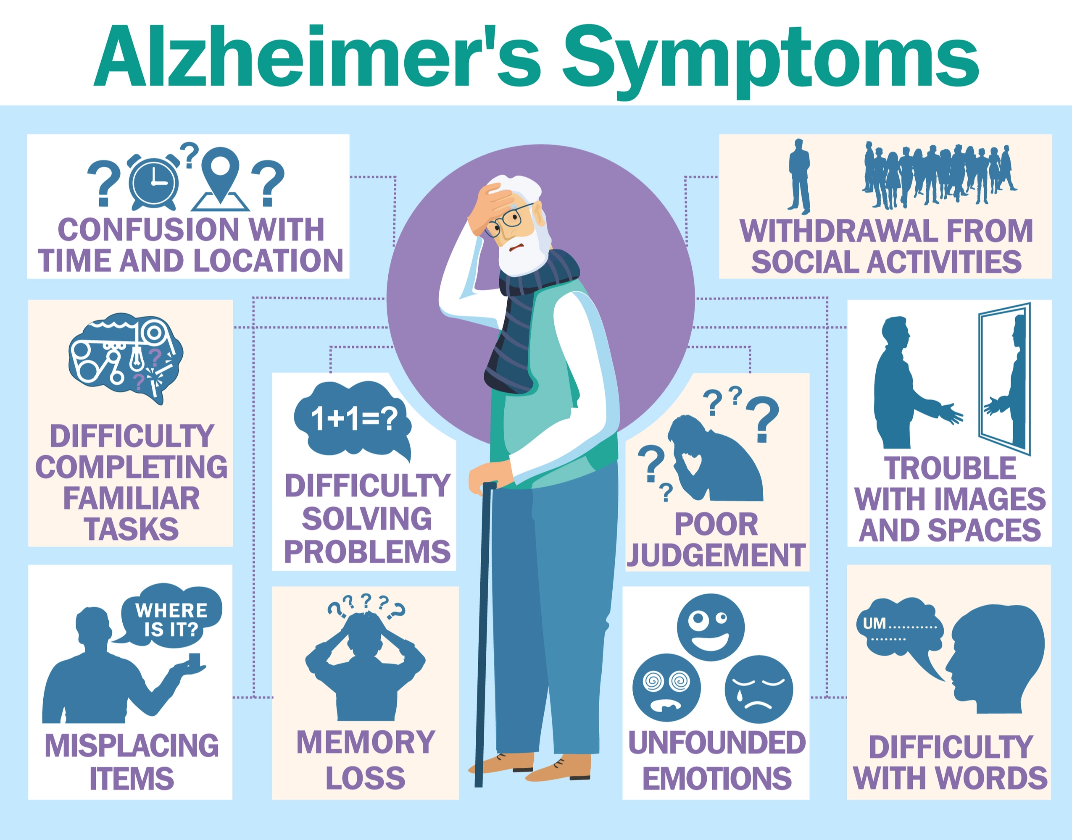
Introduction- Symptoms of AD
Loss of memory.
Problems with speaking, reading or writing.
Hyper or impulsive unpredictable changes in behavior[2]

Slide 8
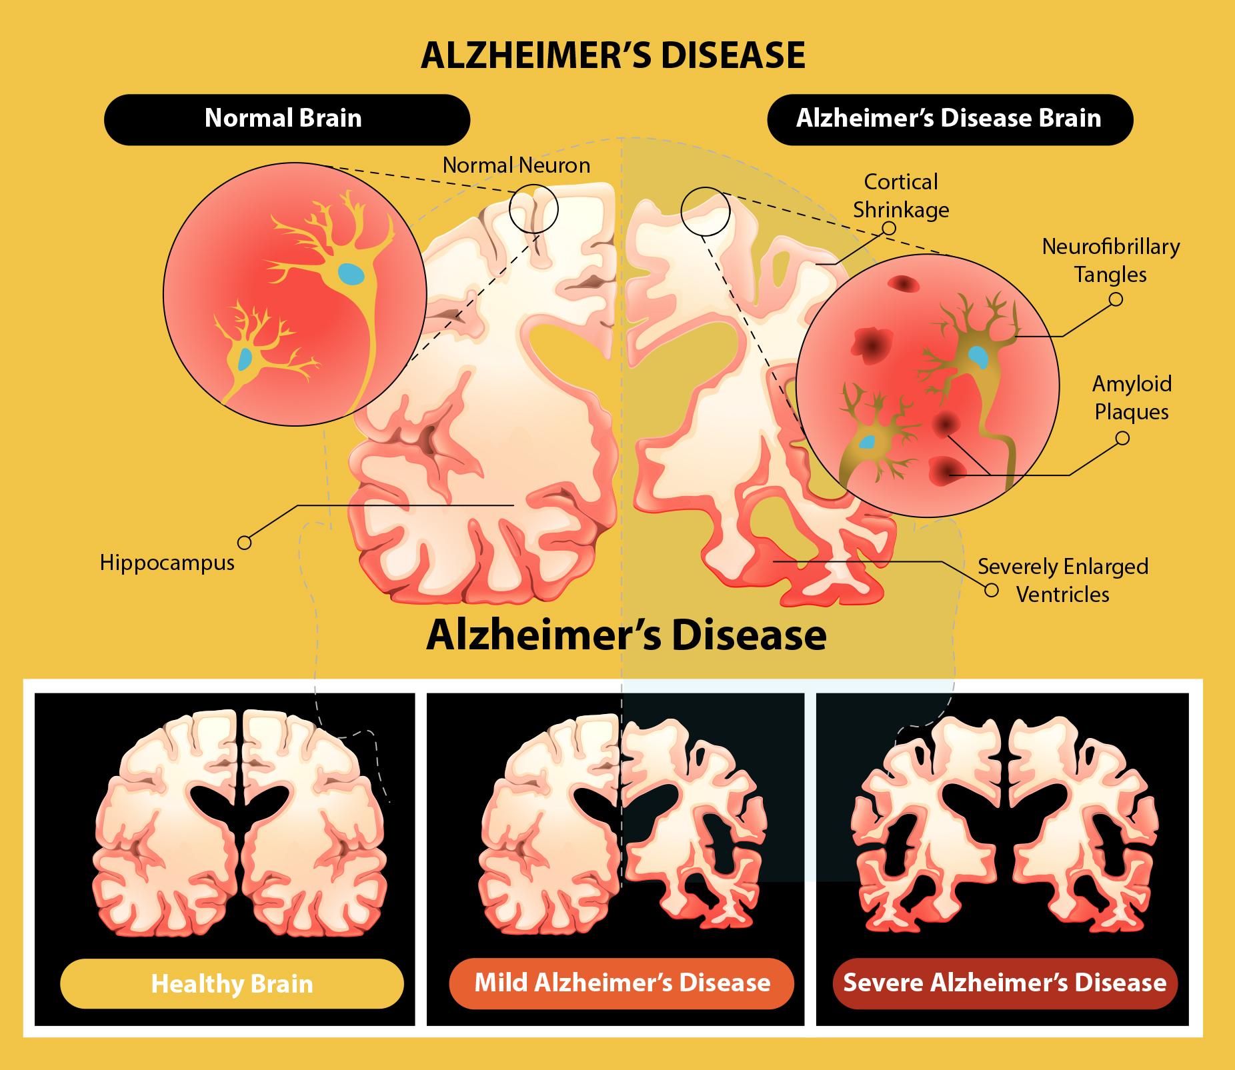
Introduction- Causes of AD
There are several risk factors, including genetic risk. (Apolipoprotein E4 -apoe4) , age, depression, hormonal changes, cardiovascular factors-hypertension, diabetes, complications during pregnancies, etc.
One of the hypothesized mechanisms that cause AD is the presence of beta amyloid plaques and tau tangles in the brain.
The vascular system may fail to supply the brain with adequate blood and nutrients.The brain can lack sufficient glucose to fuel its function.
Brain atrophy, or loss of neurons. As brain cells die, the brain shrinks in AD, typically starting with the hippocampus, a section of the brain that is essential for learning and memory, and other memory-related structures, such as the entorhinal and perirhinal cortex.

Slide 9
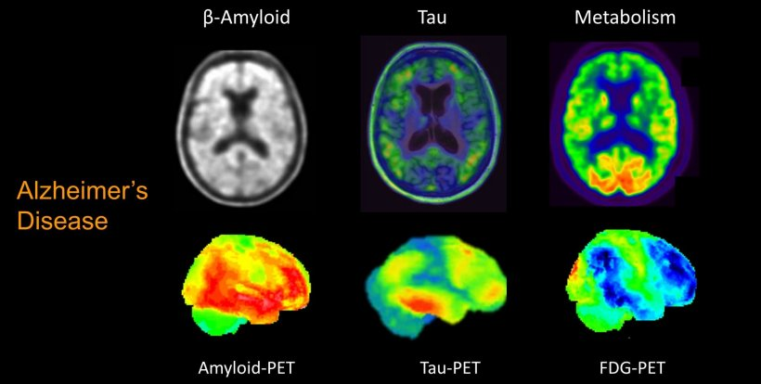
Introduction- Tools for Diagnosis
For the development of successful treatments, it is important to gain a better understanding of molecular and cellular processes and how they can interact. Brain imaging advancements allow us to see the development of plaques and tangles in the living brain. Blood and fluid biomarkers provide insights into where and how the illness begins and progresses. Also, quite importantly, as there is measurable atrophy occurring in several brain regions during the progression of the disease, another important set of biomarkers can be derived through Magnetic Resonance Imaging (MRI), for example, through brain morphometry, i.e., measurements of brain area volumes, and cortical thicknesses. This is one of the main avenues pursued in our work, using volumetric measures acquired in the ASPSF and PRODEM datasets.

Slide 10
Introduction-Towards developing treatments
Much is now understood about the molecular underpinnings of the condition and how cellular processes can be affected. These developments allow potential new therapies to be developed and tested, including medications that decrease the propagation of tau and amyloid proteins in the brain, cardiovascular system therapies, glucose metabolism, and inflammation, and lifestyle measures such as exercise or diet, and behavioral approaches such as socialization that may promote brain health. Although intense research is underway, the studied interventions have so far not been successful at preventing the dementia stage. This lack of success could potentially be caused by heterogeneity, i.e., variability in disease pathogenesis. Heterogeneity could be caused by sex differences(different courses of disease between men and women), which is the subject of this study. Industries in the last two decades have been investing heavily in many clinical trials for different types of interventions. In several studies done in the last two decades, it has been found that A.D. begins 10-20 years before any noticeable symptoms are detected[13]. Hence, new trials aim to track the initial stages of the disease. Current medications (cholinesterase inhibitors and memantine) are applied only in the later stages. However, recently, research has been focusing on pre-dementia stages of the disease, even cognitively normal individuals, such as the ones included in one of the datasets studied. Exploring individual differences, including those related to differences between males and females, can promote the development of new treatment strategies that can be more personalized (better suited for a specific group of individuals) and thus potentially more effective.

Slide 11
Introduction: Why study progression of AD?
AD over time leads to dementia, which is a stage where the patient loses the ability to carry out their everyday tasks and becomes dependent on outside help. Alzheimer’s pathology is not the only cause of dementia. However, it remains the most frequent, with 60-80% of dementia cases reported to be Alzheimer's cases. It is worth noting that AD is not an unavoidable part of aging; many people never develop the disease. Scientists believe that earlier intervention can help slow dementia's progress. The earlier you intervene in the progression of the disease, the better the outcome for patients. There are several assumptions as to why the clinical trials haven't yet been successful[15]. One of the reasons could be that it's heterogeneous, which means that there are many different variations of the disease appearing as one and that men and women have slightly different variations of the disease.

Slide 12
Aims and Objectives
AIM 1
AIM 2
Using appropriate models to analyze the effect of the response variables sex, age, hypertension (in ASPSF only), and brain morphometry measurements as independent variables (model 1). Also investigating the inverse models (with brain morphometry as response variables, model 2).
Objective : Expose patterns in the results of Aim 1 and discuss strength and potential explanatory hypothesis.
Using appropriate methods, cross-sectionally model the effect of age, education, sex, and brain morphometry measurements on a cognitive measure, and then disaggregating by sex to see if the results differed between men and women.
Objective : Expose patterns in the results of Aim 2 and discuss strength and potential explanatory hypothesis.

Slide 13
DATASET
The datasets have been provided by the University of Graz. After signing appropriate Non-Disclosure as well as Data-Sharing agreements with the project partners (from the University of Graz and Women's Brain Project), subsets of the Datasets became available for initial exploration and wider subsets of the totality gradually became available too. The rows in these datasets are the patients whose data was recorded. The count of the rows need not necessarily show the exact count of patients because some patients have been given the tests over multiple consultations (visits). This was done to track the progression of the patient.
The datasets used for this study, are divided into two cohorts: First, the ASPSF cohort consisted of healthy (cognitively unimpaired) subjects, followed both cross-sectionally (379 subjects) and longitudinally (119 subjects). Among the 114 subjects selected after applying inclusion and exclusion criteria, there were 55 males and 59 females with two data points. The dataset included brain volumetric measures, cognitive tests, as well data on comorbidities (e.g., cardiovascular risk factors). The second cohort, PRODEM, comprised patients with dementia. After applying pre-specified inclusion and exclusion criteria on the PRODEM dataset, the dataset included a total of 48 longitudinally followed patients, of which 27 were males, and 21 were females. For both datasets, we only selected non-depressed patients (Geriatric Depression Scale < 5). For ASPSF, we excluded patients with Mini Mental Status Exam (MMSE) <= 24, while for PRODEM, we only included those with “probable Alzheimer’s disease”.

Slide 14
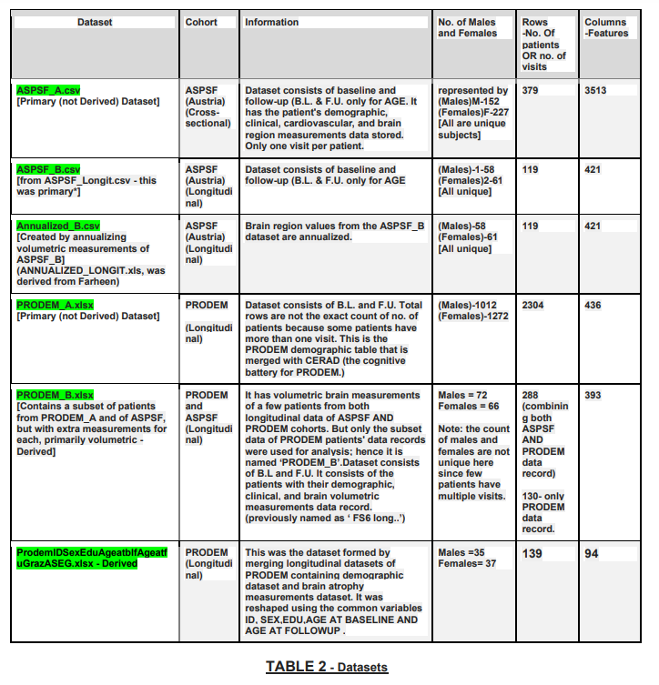
DATASET- About data
The datasets given are of cross-sectional and longitudinal types. In the ASPSF_B dataset, which consists of longitudinal data, each patient in this dataset has a baseline and a follow-up record, i.e., two-time points record. This dataset was reshaped according to the instructions and was stored as 'ANNUALIZED_B.xlsx'. Similarly, ‘PRODEM_A.xlsx ‘is reshaped and stored as ‘ProdemIDSexEduAgeatblfAgeatfuGrazASEG.xlsx’( both consist of patient data recorded at multiple time points - Longitudinal data)

Slide 15
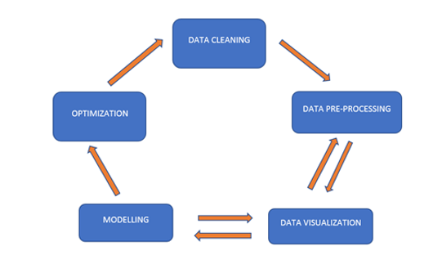
Research Methodology
Data Lifecycle Implemented

Slide 16
Research Methodology: Data Preprocessing
For the pre-processing cleansing steps in the PRODEM dataset, it was recommended by doctor Martinkova to exclude those that have:
a) missing values (N.A.s) in the CERAD battery, as those are not from Graz
b) include only those that have the "demenzart" column = 1 (those have probable A.D by the clinical criteria) c) exclude those that have "gdssum" 5 or higher (this means they are depressed, which affects cognitive function) [30]
For the clean-up in the ASPSF dataset, it was instructed to:
a) to change the brain structures measurement values to annualized values.
b) Exclude. MMSE (<=24)- Indicates possible dementia[31]
c) exclude those that have "gdssum" 5 or higher (this means they are depressed, which affects cognitive function)

Slide 17
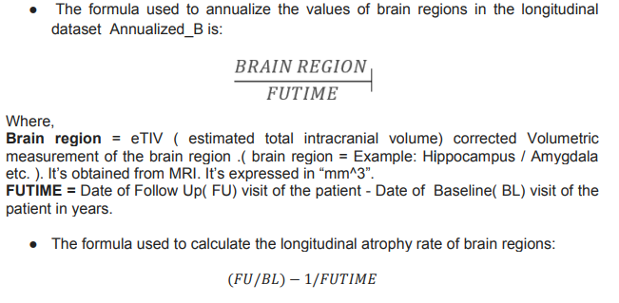
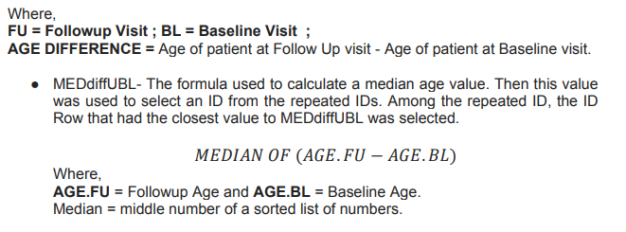
Research Methodology: Data Preprocessing
FORMULAS USED FOR PRE-PROCESSING:

Slide 18
Research Methodology- Analysis assessing tool
The p-value was used to test the statistical significance that indicates the high-risk or high effect on features. The code implementation was based on statsmodel.api or ANOVA package in Python using Jupyter Notebook. As is the usual norm, a p-value that is p<= 0.05 is considered to be statistically significant. But we also separately included results that have a p<=0.1.

Slide 19
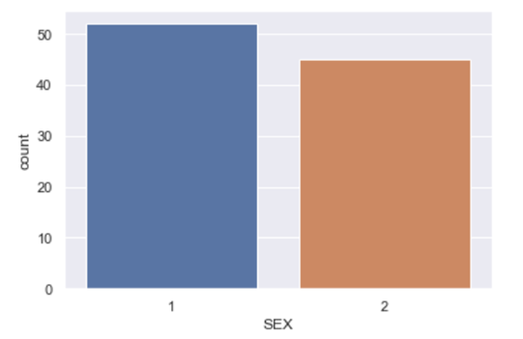
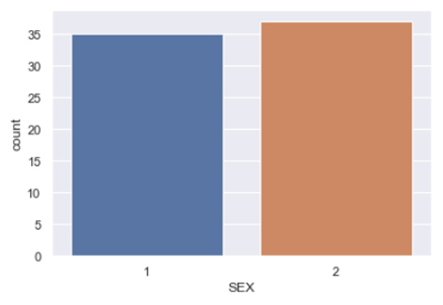
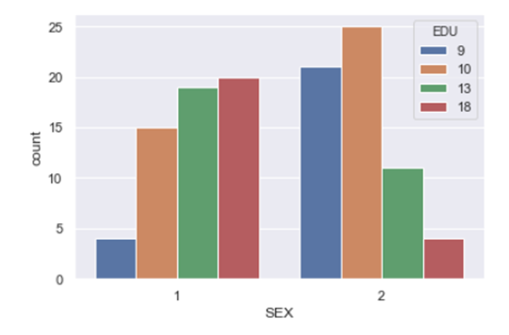
Research Methodology- Data Visualization
Countplot of males and females. Blue bar ‘1’ represents the number of males, and Orange bar ‘2’ represents the number of females. (Dataset ANNUALIZED_B)
The bar graph shows that the number of males represented as ‘1’ is more in this data than women who are represented by ‘2’. Before data cleaning, the Count of MALES represented by 1 was 52. The Count of FEMALES represented 2 was 45
Countplot of SEX ‘1’ represents males ‘2’ females, counted according to unique IDs without multiplicity for those having more than one visit. [Dataset ProdemIDSexEduAgeatblfAgeatfuGrazASEG, i.e. PRODEM_B as
The visual tells us the count of women is higher in this longitudinal dataset. By excluding the repeated scans per patient. The total count of Males = 35 and Females = 37.
er the table of section 3.2.1]
Countplot of SEX with setting EDU as hue
The colored Bars indicating ‘9’,’10’,’13’, and ‘18’ are levels (number of years) of Education. (Dataset ANNUALIZED_B). For example, categories of jobs that people have in the ‘9’ level type are - housewife ( Hausfrau in German), cook, industrial clerk, commercial clerk, etc. It can be said that level ’9’ has people not very highly educated and with small pay jobs. Whereas the categories of jobs that people in level ‘18’ have are - Electrical engineer, Catholic pastor, industrial engineer, jurist, etc.

Slide 20
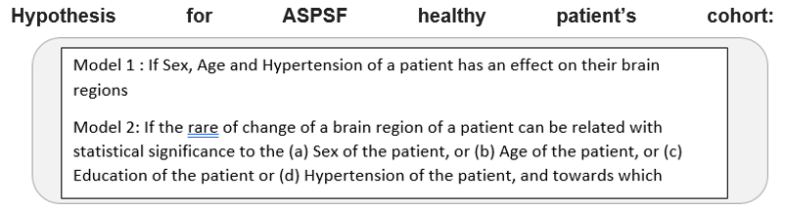
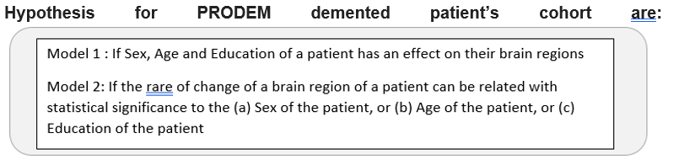
RESULTS – AIM 1 Hypothesis

Slide 21
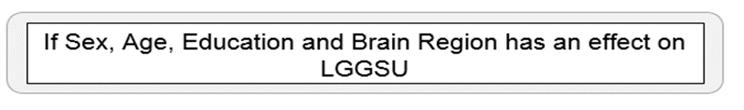
Results- AIM 2 Hypothesis

Slide 22
RESULTS
Aim 1: In the longitudinal dataset of cognitively healthy individuals (ASPSF), for model 1: No brain regions’ longitudinal change showed a significant association with age at baseline or at follow-up (at statistical significance threshold < 0.05). The brain region L.lateralorbitofrontal (left lateral orbitofrontal cortex thickness) did have a significant association with sex (beta = 1.4907 ;p = 0.0201). The following brain regions had a significant association with hypertension: R.fusiform with beta = 136.6443; p = 0.0244 , Left.Thalamus Proper with beta = 171.8423; p =0.0323 , R.entorhinal with beta = 47.8808; p = 0.0372 and Left.Caudate with beta = 74.9066; p = 0.0406. For model 2: no regions had a significant association with sex at the 0.05 significance level. Right hippocampus was associated with both baseline and follow-up age (beta = -0.0003, p =< 0.05 were between age (both baseline and follow-up) and optic chiasm, as well as between education and left ventral DC (diencephalon).
Aim 2: In the cross sectional dataset of the ASPSF cohort, we created models of cognitive function (a general memory measure, LGSSU) and disaggregated them by sex. Results show that higher education is associated with better memory performance, while higher age is associated with worse. Interestingly, we observed a slight sex difference in the age association, with the age-related decrease affecting women less than men (beta -7.8 and -4.15 for women and men, respectively). After including structure volumes and performing feature selection, the region Left.Cerebellum.White.Matter appears to have an independent effect on memory performance (with no sex difference), while the Right.choroid.plexus seems to have a significant effect in women only.

Slide 23
Discussion
In AIM 1 ASPSF results, for
model 1:Y1=SEX, Y2=AGE.BL, Y3=AGE.FU and Y4= HYPERTENSION ~ Xn=Brain Regions) AND model 2 (Yn=Brain region~Xn=SEX+AGEBL+AGE.FU+EDU)
First observation: G temporal middle and AGEBL and AGE.FU shows a degree of statistical significance in both model 1 and model 2. While the association is significant at the p < 0.05 level for Model 2, it is only significant at the p < 0.1 level for model 1.
Similarly, the association between Right Hippocampus and AGE.BL and AGE.FU was significant at the p < 0.05 level in model 2 and significant at the p<0.1 level in model 1.
-> This result was to be expected, as it is known that medial temporal lobe regions progressively reduce their volume with age [35]. Our analysis shows a borderline significance in model 1, implying that this relationship is so strong that, mathematically, the more atrophy is found, the more likely the person is to be aged. The lateralization of these findings requires further investigation.
Second Observation: Left Caudate and Left Thalamus Proper show a significant association with HYPERTENSION in both models (at the p < 0.05 level in model 1 and at the p < 0.1 level in model 2).
-> This result points to a close relationship between hypertension and atrophy of basal ganglia and thalamus. This is in line with previous results that point to a negative effect of hypertension on brain volumes in these structures[36].
Third Observation: L.lateral orbitofrontal is a significant association with SEX in both models (at the p<0.05 level in model 1 and at the p < 0.1 level in model 2).

Slide 24
Discussion
In AIM 1 PRODEM results:
Model 1 (Y1=(SEX), Y2=AGE.BL, Y3=AGE.FU, and Y4= EDU ~ Xn=Brain Regions)
First observation: Although we have a relatively small dataset, we do get a number of brain regions that appear to have strong statistical significance for most of the combinations of parts P1-P6 (i.e., subsets of brain morphometry measurements) with the four dependent variables that we chose (SEX, AGE.BL, AGE.FU, EDU). Of course, these should be taken as indicative given the size of the dataset; however, they are still results worth reporting, even more so in order to be cross-checked in the future with larger datasets.
Second observation: There seems to be quite some L-to-R hemisphere asymmetry regarding the brain morphometry measurements that are significant: This can be easily be verified by looking at the whether any significant measurement for the case of subset P2 (Left hemisphere) has its equivalent Right hemisphere measurements included in P3 and vice-versa; and similarly for P5 (Left) with P6 (Right).

Slide 25
Discussion
Third observation: There seems to be quite some overlap in the significant features (morphometry measurements) for the dependent variable AGE.BL with those for the dependent variable AGE.FU, as is to be expected; in more detail, the percentages of overlap for the green band (0.05) are:
P1 = 100% ,
P2 = 100% ,
P3 = 100% ,
P4 = 90%.( Right vessel is present in the green AGE.BL and not in the green of AGE.FU but in the yellow of AGE.FU) ,
P5 = 90%(CC_Central_Volume is present in the green of AGE.BL but not in the green of AGE.FU but present in yellow of AGE.FU),
P6 = 100 %
The percentages of overlap for the green and yellow bands i.e ( <0.05 and 0.05<p<0.1) are :
P1 = 90 % ( CSF::Volume present in AGE.FU and not in AGE.BL) ,
P2 = 100 % ,
P3 = 100 % ,
P4 = 90 % ( Left_VentralDC present in AGE.FU and not in AGE.BL) ,
P5 = 90 % ( Cortex_Volume is present in AGE.FU and not in AGE.BL)
P6 = 90 % ( Right_Amygdala is present in AGE.BL and not in AGE.FU)
{It can be observed in Result 2 and Result 3. The significance of brain morphometry measurements in both Age baseline and follow-up are similar except for the brain regions ‘Right-Vessel’ and ‘CC_Central_Volume’; they drop their significance slightly in the follow-up AGE. }

Slide 26
Discussion
In AIM 1 PRODEM results:
Model 2 (Yn= Brain region ~Xn=SEX+AGEBL+AGE.FU+EDU)
Cerebral White Matter (C), Left Cerebral White Matter (L), and Right Cerebral White Matter (R) show a borderline significant (significant at the p<0.1 level) association with AGE.BL and AGE.FU.
-> This result is to be expected as age increases the risk of white matter alterations. Interestingly, there was no association with sex; this could mean that white matter changes over time are independent of sex or be due to the low number of subjects in the study. More studies will be needed to confirm this.

Slide 27
Discussion
Aim 2 : Here, we modeled the effects of several variables on a general memory measure (LGSSU). The analyses were performed on both sex-disaggregated and non-sex-disaggregated data. We observed that education had a positive association with memory performance. This is expected since higher education has been associated with both better cognitive performance and a lower risk of developing dementia[37]. In a similar vein, age had a negative effect on memory performance – age-related memory decline is also a widely recognized phenomenon[38]. Interestingly, after sex-disaggregation, age-related decline appeared to be more prominent in males than females, indicating overall higher preservation of memory in ]females with age. Since the LGT-3 test does include a prominent verbal memory subsection, this result could be related to the known female advantage in verbal memory[39].
Our results also indicated several regions that appeared to have a sex-specific effect on memory performance, most notably the right choroid plexus in women only. The choroid plexus is a structure lining the ventricular chambers that are responsible for producing cerebrospinal fluid. In addition, it performs other functions, including forming the hematoencephalic barrier and harboring immunologic defenses of the brain. An increase in choroid plexus volume has been linked to aging [40] and several diseases, including Alzheimer’s disease[41], although no sex difference (explored only in aging) has been noted so far. This female-only link between a memory measure and choroid plexus volume could be linked to female-specific cognitive changes, perhaps related to immunologic differences[42]. More research is needed to better understand this sex difference.

Slide 28
Future work and Conclusion
In this work, the rich datasets acquired from the University of Graz were utilized extensively to create models of longitudinal atrophy and cognitive (memory) performance in healthy subjects and patients with Alzheimer’s disease. We specifically looked for potential sex differences, as well as education, age, and hypertension effects.
In the longitudinal dataset of cognitively healthy individuals (ASPSF), we detected a number of regions associated with the studied variables. Most notably, right hippocampus volume change was associated with age both at baseline and follow-up, which is likely related to the general progression of medial temporal lobe atrophy with age. Basal ganglia (caudate nucleus) and thalamus were associated with hypertension, consistent with earlier findings of morphologic changes of these structures in hypertense individuals.
In the longitudinal dataset of the PRODEM cohort, we also observed a large number of associations, of which we noted the borderline significant relationship between cerebral white matter and age.
In a sex-disaggregated model of memory performance, right choroid plexus volume seemed to have an effect on memory in women only, which could point to a female-specific, perhaps immunologically mediated, the relationship between memory and the choroid plexus.
Our results point to potential age-AD risk factor- and sex-related differences in both healthy individuals and patients with AD, which could have implications for future precision medicine studies.

